Slide 1
AI Intro Basics #2
Dynamics, Data Recovery, Data Assimilation Examples
Roland Potthast, Stefanie Hollborn and Jan Keller

Slide 2
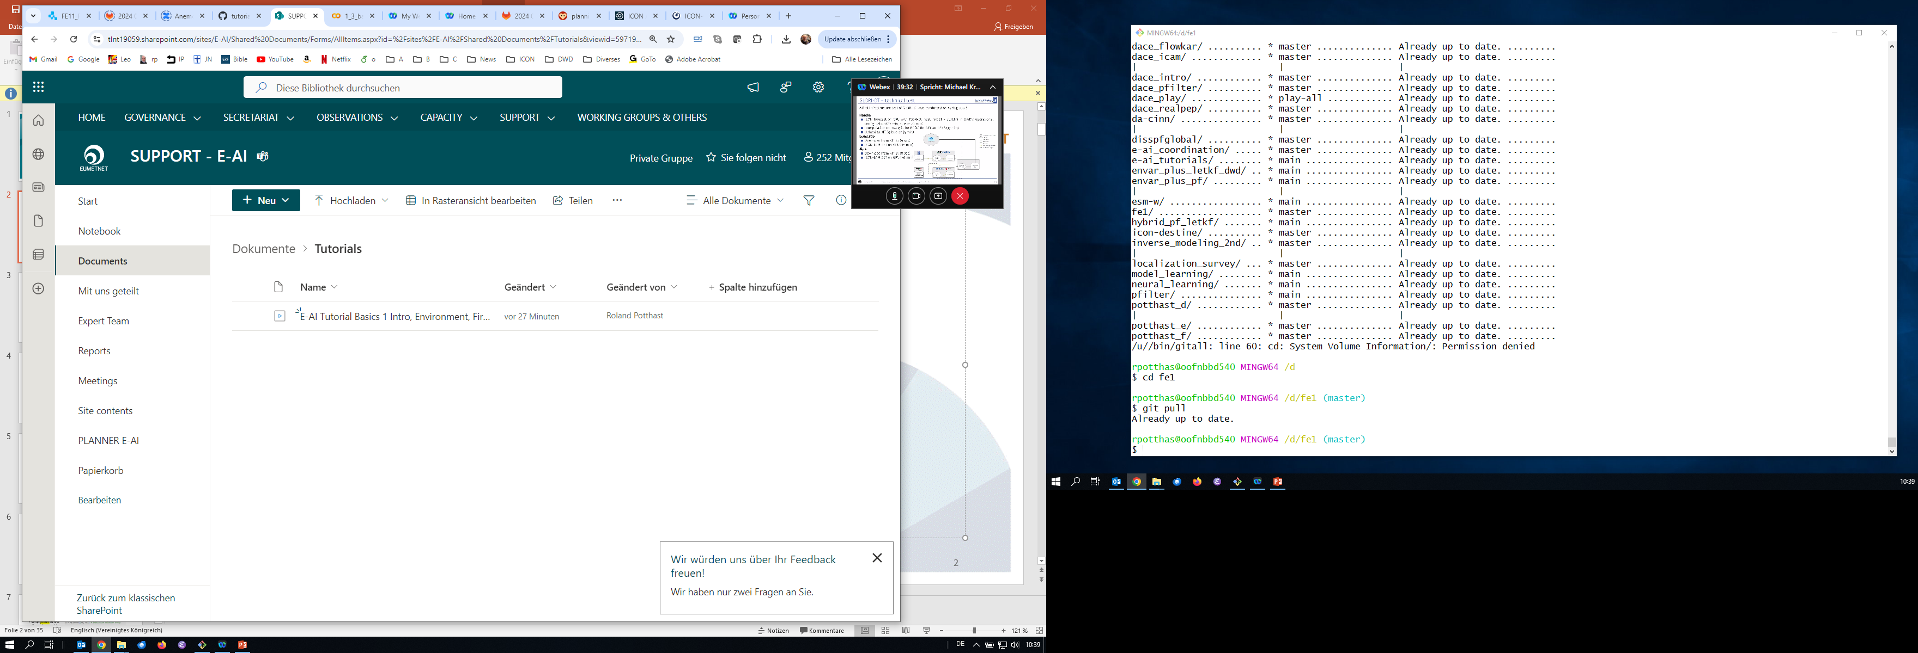
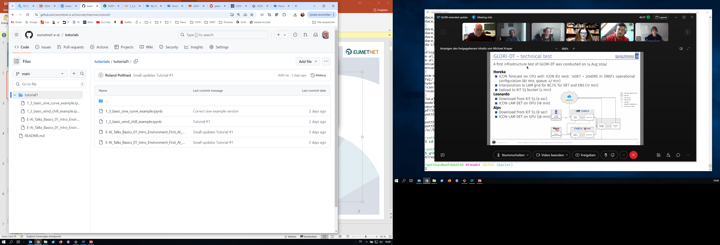
Material / Tutorials
Recordings available on Sharepoint
EUMETNET E-AI Sharepoint
https://tlnt19059.sharepoint.com/sites/E-AI/SitePages/CollabHome.aspx
Github eumetnet-e-ai Repo
https://github.com/eumetnet-e-ai/tutorials/
To get access to EUMETNET SharePoint write an email to marek.Jacob@dwd.de
Codes and Slides available on Github

Slide 3
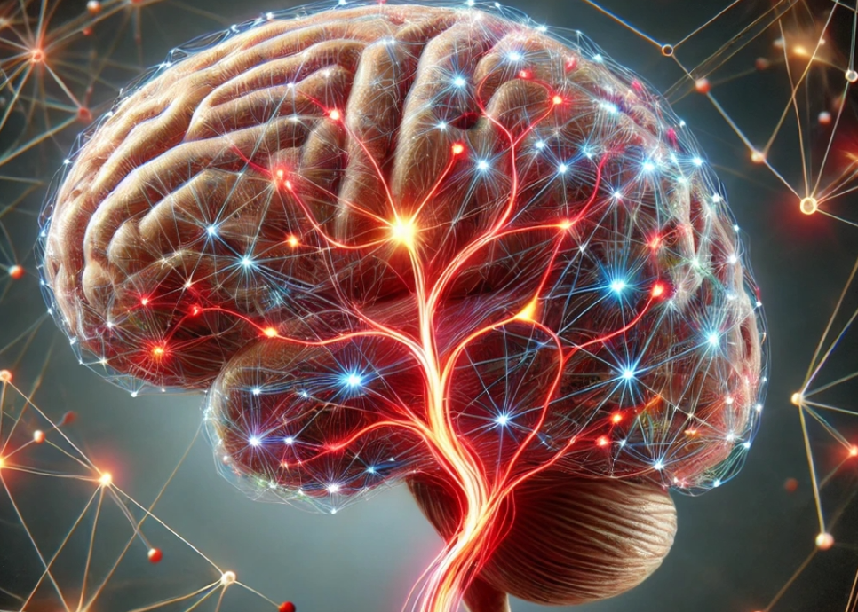
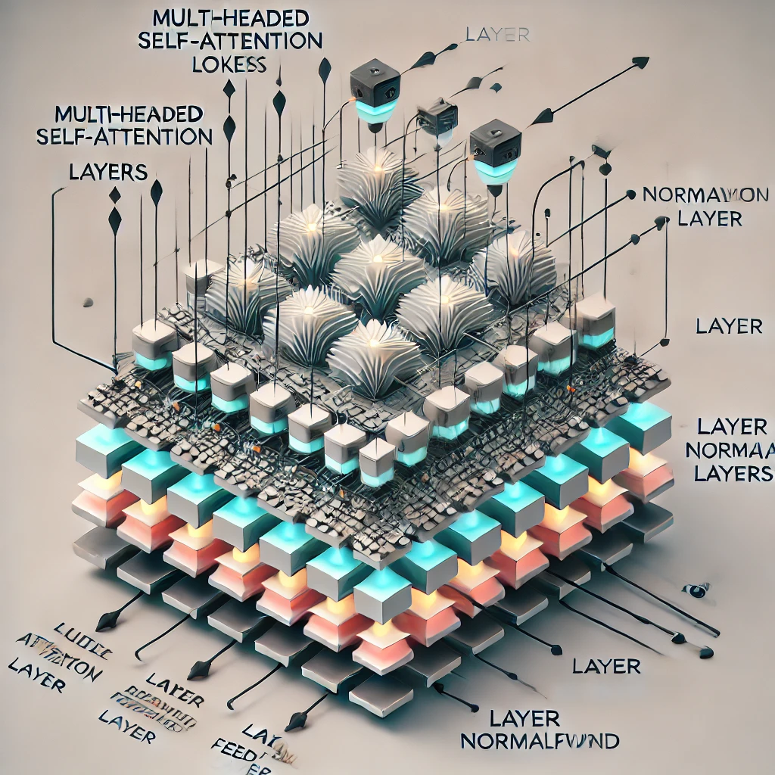
E-AI Basic Tutorials
Tutorial E-AI Basics 1: September 16, 2024, 11-12 CEST
Intro, Environment, First Example
1.1 Basic Ideas of AI Techniques (20') [SH]
1.2 Work Environment (20') [RP]
1.3 First Example for AI - hands-on (20') [JK]
Tutorial E-AI Basics 2: September 18, 2024, 13-14 CEST
Dynamics, Downscaling, Data Assimilation Examples
2.1 Dynamic Prediction by a Graph NN (20') [RP]
2.2 Data Recovery/Denoising via Encoder-Decoder (20') [SH]
2.3 AI for Data Assimilation (20') [JK]
Tutorial E-AI Basics 3: September 23, 2024, 11-12 CEST
LLM Use, Transformer Example, RAG
3.1 Intro to LLM Use and APIs (20') [RP]
3.2 Transformer for Language and Images (20') [JK]
3.3 LLM Retrieval Augmented Generation (RAG) (20') [SH]
2.1
AI generated Images, © Roland Potthast 2024

Slide 4
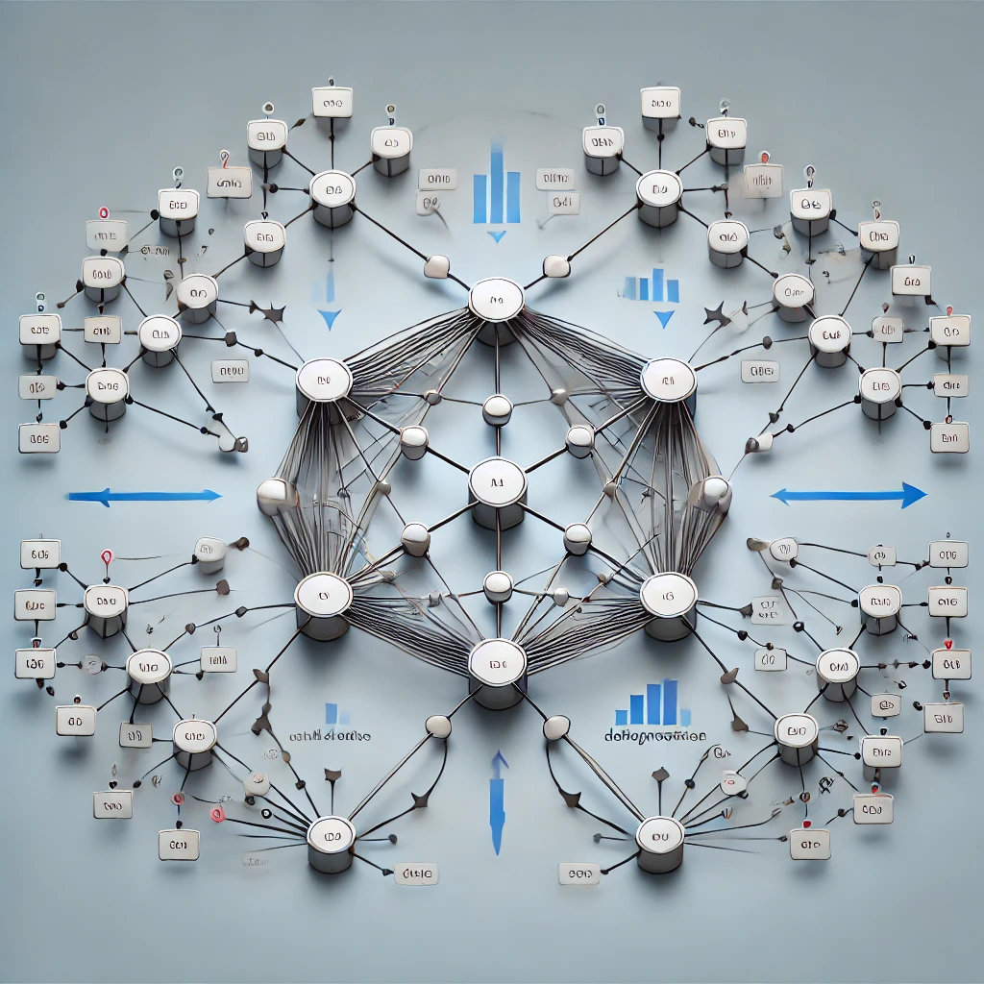
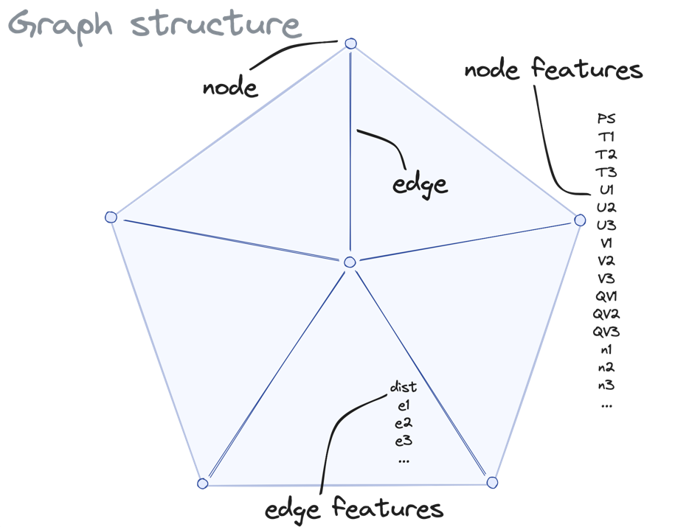
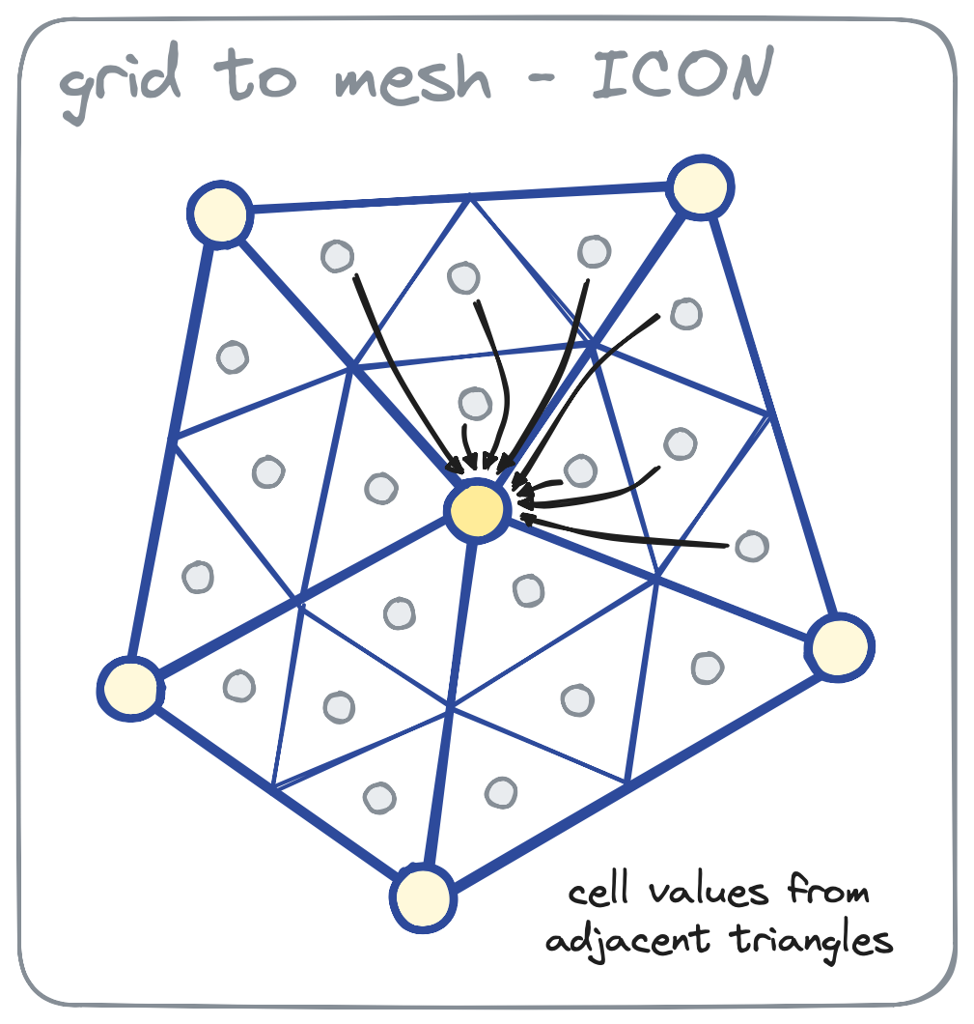
Graph Neural Networks – Basic Idea 1/2
2.1 Dynamic Prediction by a Graph NN
Graph Neural Networks (GNNs) are a type of neural network designed to work on graph-structured data, where entities (nodes) are connected by relationships (edges). Unlike traditional neural networks, GNNs use graph structures to capture both the features of individual nodes and their connectivity within the graph.
By passing information between nodes through edges, GNNs allow for the modelling of complex relationships, making them effective for tasks like social network analysis, molecular modelling, and recommendation systems.
GNNs leverage techniques like message passing to aggregate and update node representations based on their neighbours.
To construct a graph, start by defining its nodes (vertices), which represent individual entities in your data. Then, establish edges between these nodes, representing the relationships or connections between the entities, forming the structure of the graph.

Slide 5
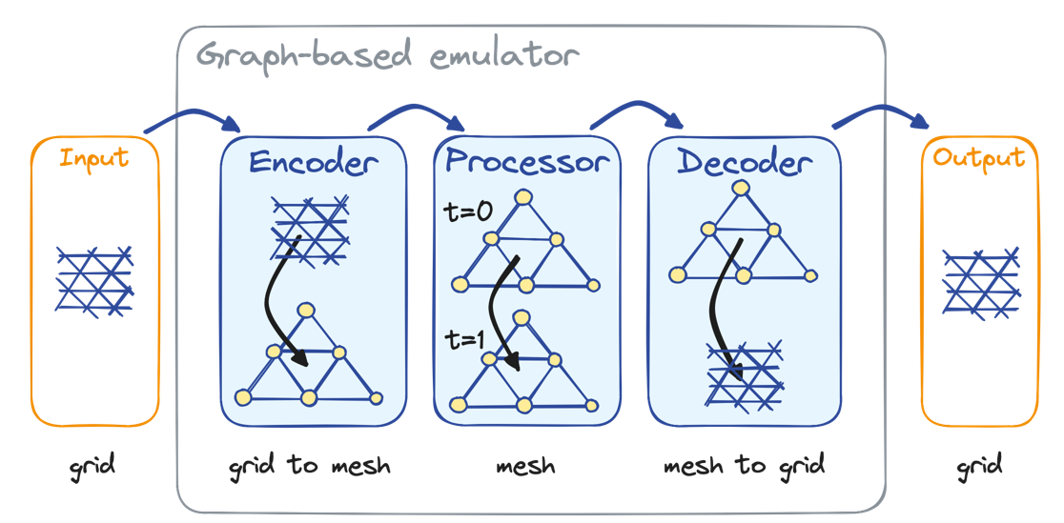
Graph Neural Networks – Basic Idea 2/2
2.1 Dynamic Prediction by a Graph NN
In graph-based models using an encoder, processor, and decoder, the encoder transforms raw graph data, such as node features and edge connections, into an initial set of embeddings that represent the graph's structure and features.
The processor (often a Graph Neural Network) then iteratively updates these embeddings by passing messages between connected nodes, refining their representations based on neighbouring nodes and edges.
After processing, the decoder takes the updated embeddings and generates a final output, which could be a prediction about node classification, edge prediction, or a graph-level task. This framework is widely used in applications like molecular property prediction, knowledge graphs, and social network analysis.
To learn more about Graph Neural Networks (GNNs), it’s helpful to start by understanding how message passing works between nodes, where information is shared across connected nodes in the graph.
You should also explore basic GNN applications, like node classification and link prediction, which are common tasks in social networks and recommendation systems.

Slide 6
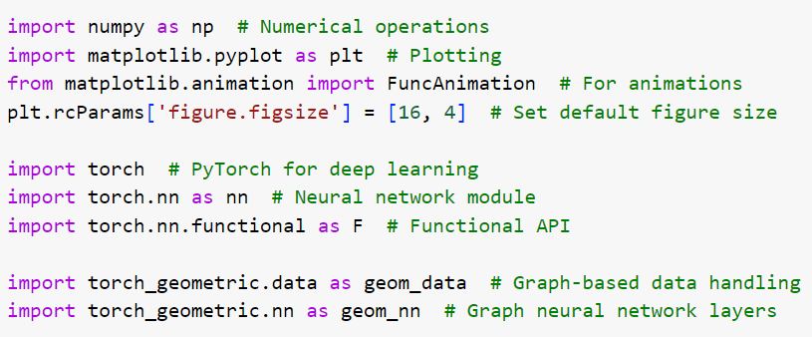
Import the necessary Libraries
Import ML Libraries needed for your project.
You might need to install some packages as shown here.
We rely on PyTorch mainly for our tutorial.
PyTorch was primarily developed by Facebook's AI Research (FAIR) group, but made an open source project and is widely used.
To achieve reproducibility we set the seed.

Slide 7
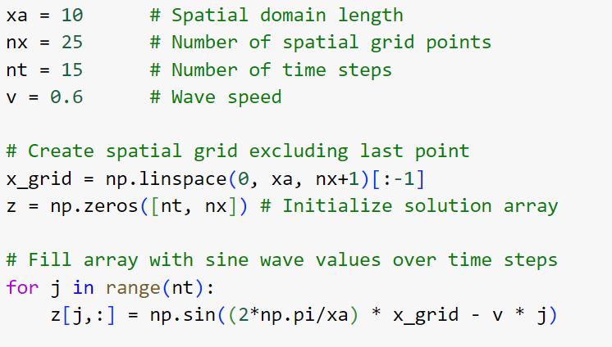
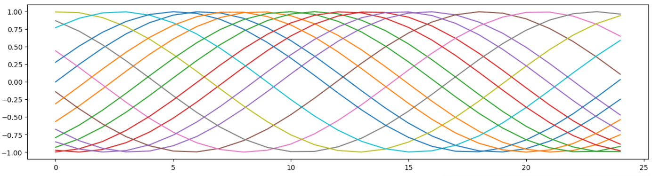
Setup simple example
We prepare a simple example of moving sinusoidal functions.
Setup points in one dimension: x_grid
Define sine functions moving with speed v.
Visualize all functions by matplotlib.

Slide 8
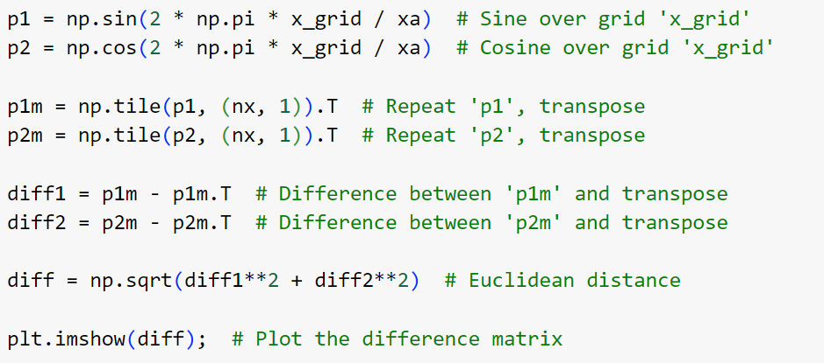
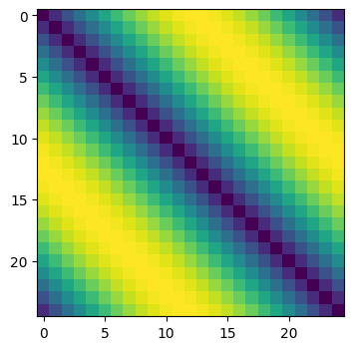
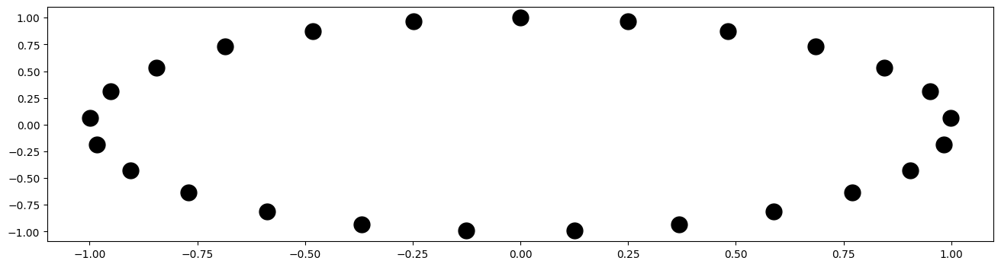
To construct a local graph, we define distances between grid points
We map our points from a line segment to a circle (p1,p2)
then calculate the difference of the first and second coordinate
And use it to calculate the Euclidean distance.
Visualize by matplotlib

Slide 9
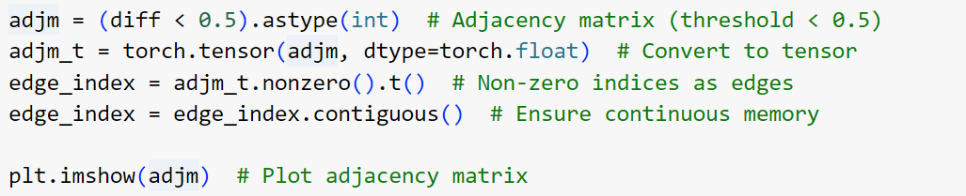
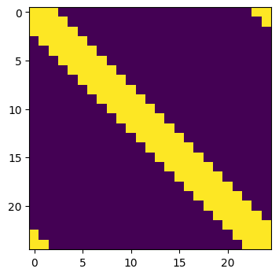
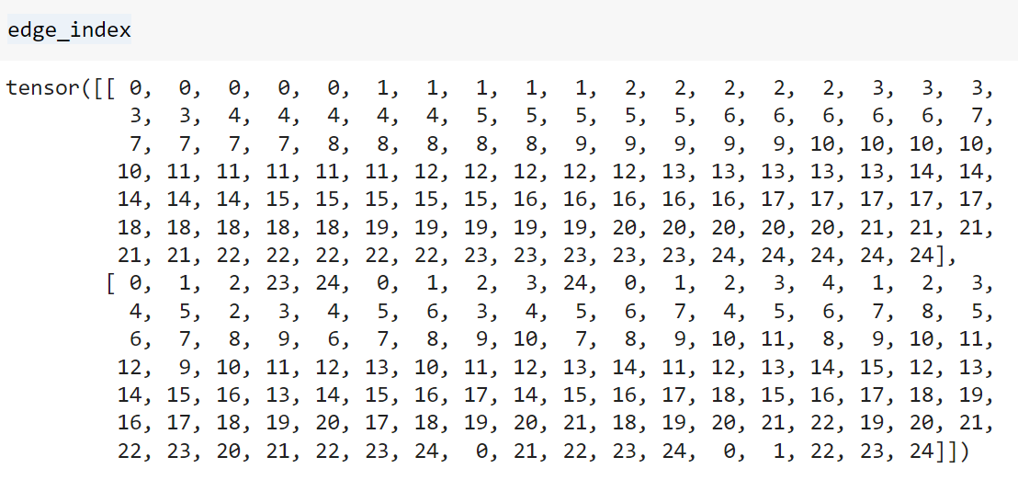
Now generate Adjacency Matrix and Edge Index
An adjacency matrix is a square matrix used to represent a graph, where each element indicates whether a pair of vertices (nodes) are adjacent (connected by an edge) in the graph.
An edge index is a list or matrix that represents the connections (edges) in a graph by storing pairs of node indices, where each pair corresponds to an edge between two nodes.

Slide 10
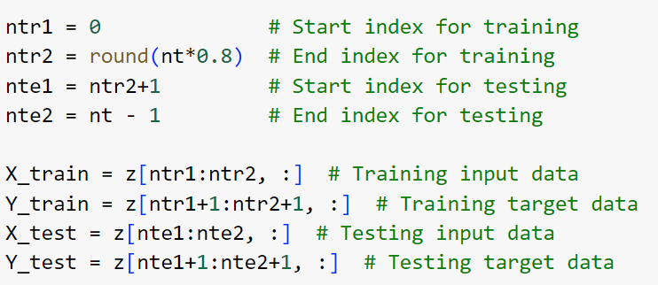
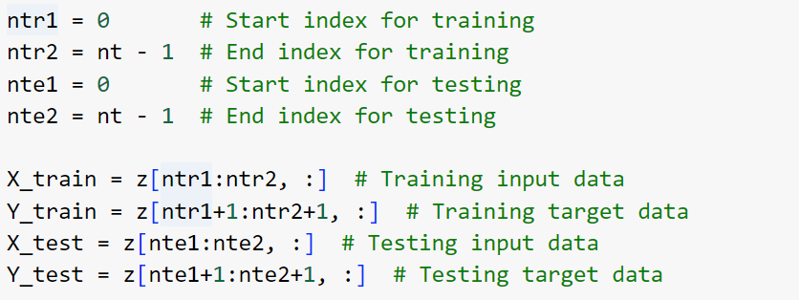
Prepare Training Data and Test Data
In this code, ntr1 and ntr2 define the start and end indices for selecting the training data, while nte1 and nte2 define the start and end indices for the testing data.
The variables X_train and Y_train represent the input and target data for training, where X_train is a slice from z, and Y_train is the next time step's data from z.
Similarly, X_test and Y_test are selected as the input and target data for testing, using slices from z for evaluation.
For the beginning one could choose training data = test data as a first simple step (to work with a very limited sample)

Slide 11
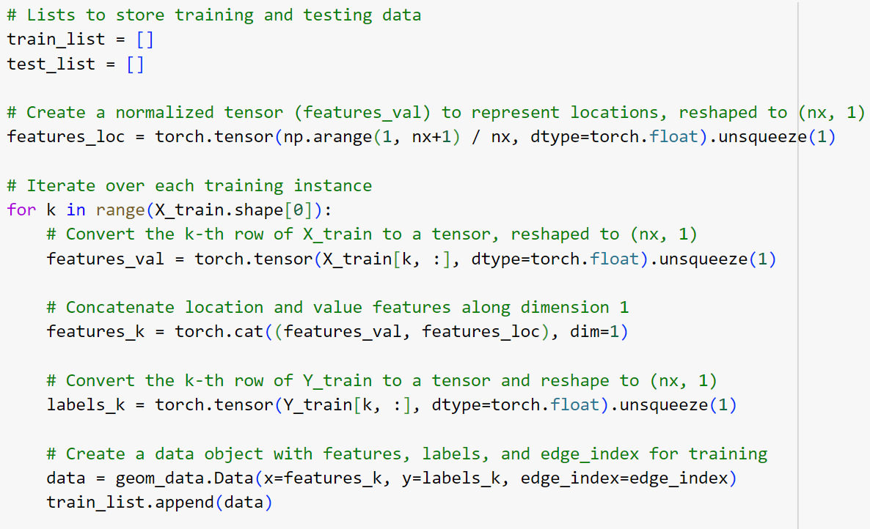
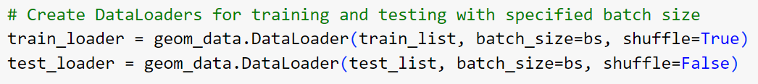
Setup the Feature Tensors and Label Tensors
We define a feature tensor features_val to represent locations (here just the indices of the points)
We define a feature tensor features_k given by the values at the points
The labels are the target values, i.e. the desired output of our neural network
In PyTorch, a DataLoader is an essential utility that simplifies the process of feeding data into a model. It combines a dataset with a sampler, handling
batching,
shuffling, and
parallel processing of data.

Slide 12
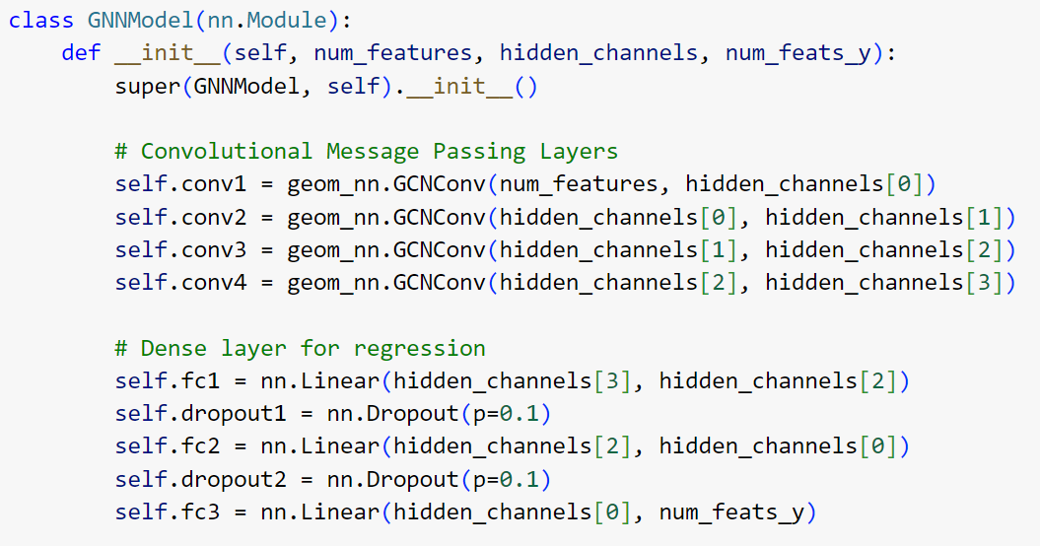
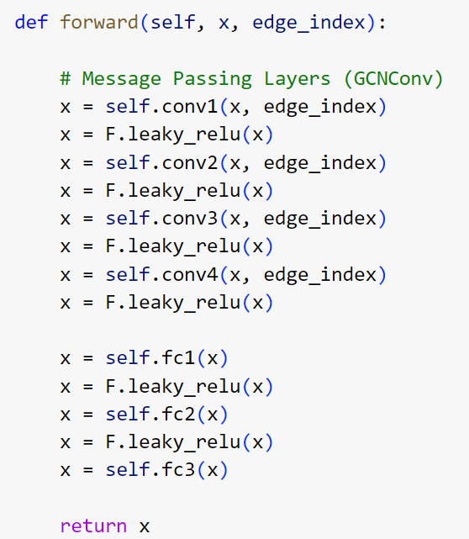
Define the Model
Initialization of Layers
Forward Propagation: The GCNConv layer, short for Graph Convolutional Network Convolution layer, is a key component of Graph Neural Networks (GNNs). It is designed to perform convolution operations on graph-structured data. GCNConv works on graphs, where nodes and edges represent relationships between entities.

Slide 13
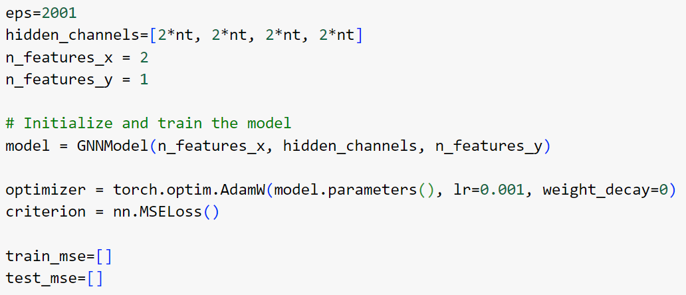
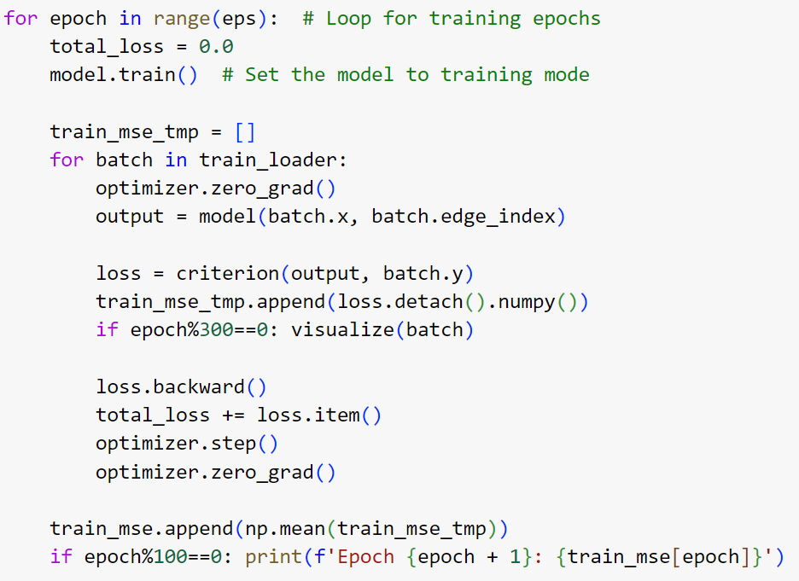
Training Loop
Training loops in PyTorch always follow a particular basic shape.
They typically start by setting the model to training mode using model.train(), followed by iterating through the data using a DataLoader.
For each batch, the gradients are zeroed (optimizer.zero_grad()), predictions are made using the model, and the loss is computed with a loss function (e.g., nn.MSELoss).
The loss.backward() call computes the gradients, which are then used by the optimizer (e.g., optimizer.step()) to update the model's weights.
This process repeats for multiple epochs, and at the end of each epoch, performance on the validation or test set is usually evaluated with model.eval() to track progress.

Slide 14
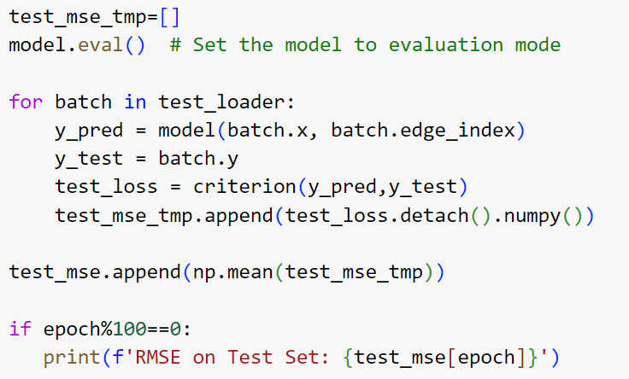
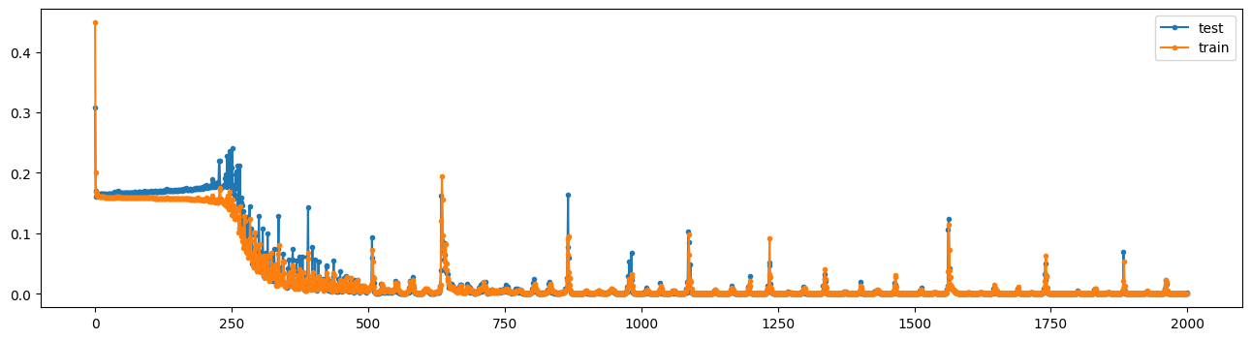
Development of the Loss Function
We evaluate the model performance on the evaluation test set, which is has not seen before.
The red and blue curves show the current model performance on the training data set and the test data set.

Slide 15
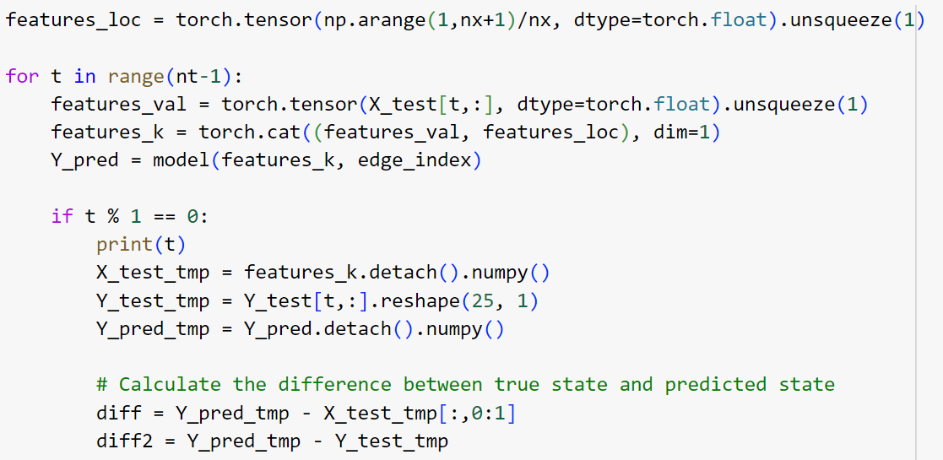
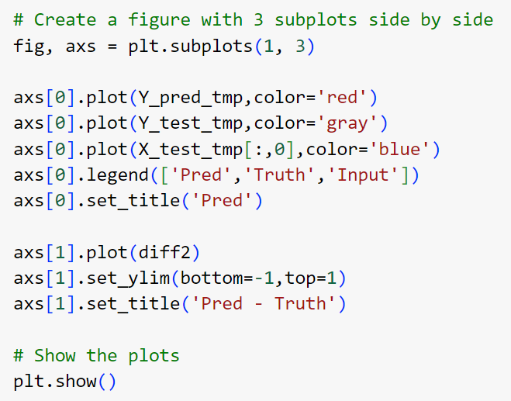
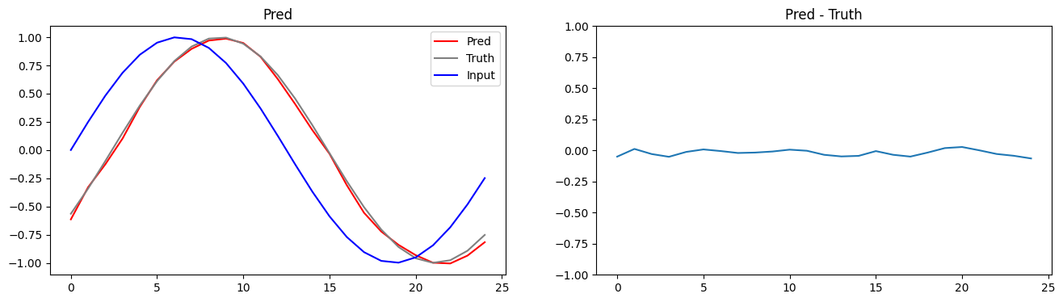
Testing the Learning Results, Visualization
For testing the outcome, we display some concrete examples.

Slide 16
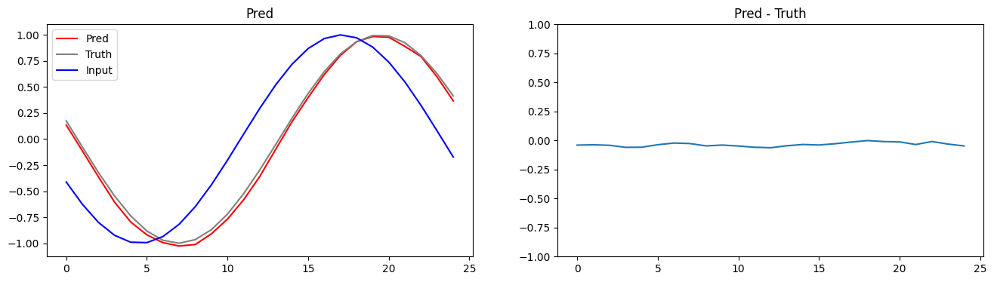
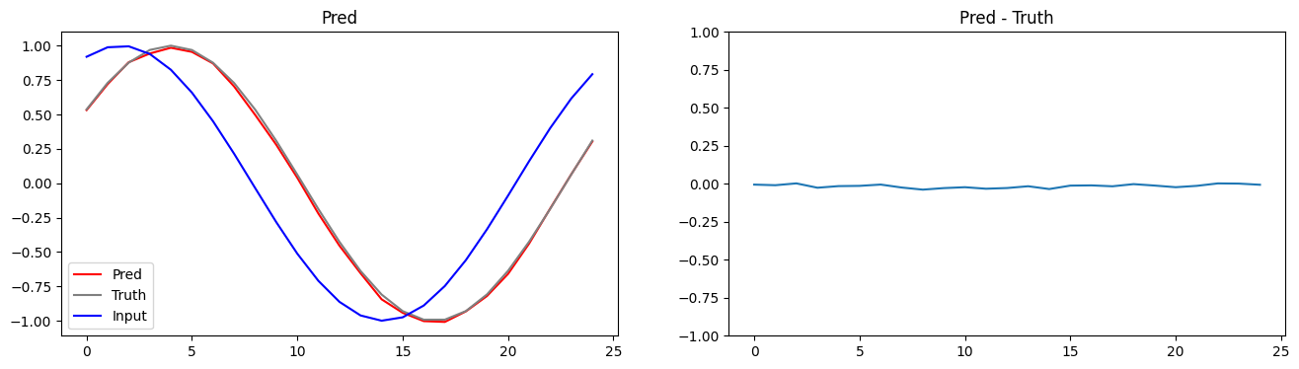
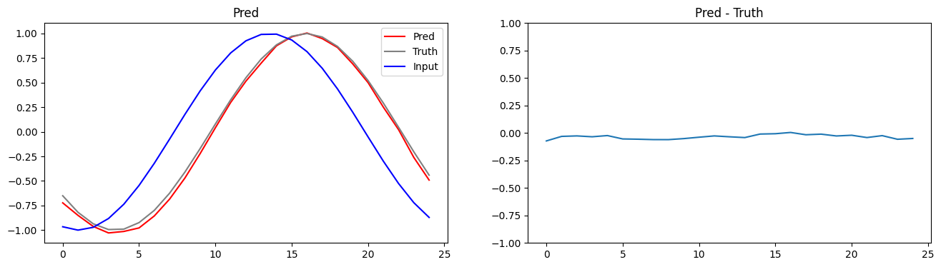
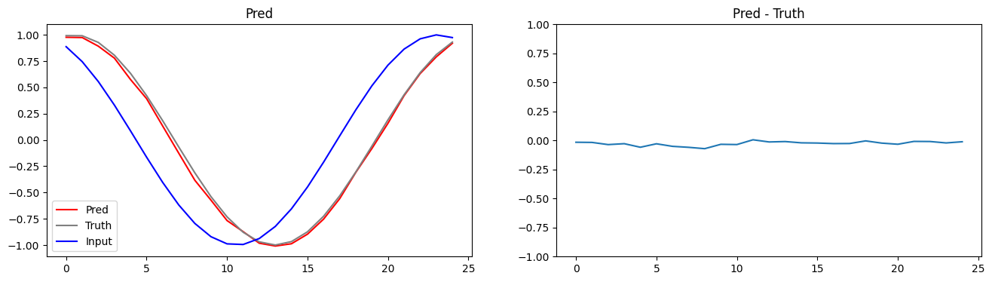
Examples from the Full Data Set

Slide 17
E-AI Basic Tutorials
Tutorial E-AI Basics 1: September 16, 2024, 11-12 CEST
Intro, Environment, First Example
1.1 Basic Ideas of AI Techniques (20') [SH]
1.2 Work Environment (20') [RP]
1.3 First Example for AI - hands-on (20') [JK]
Tutorial E-AI Basics 2: September 18, 2024, 13-14 CEST
Dynamics, Downscaling, Data Assimilation Examples
2.1 Dynamic Prediction by a Graph NN (20') [RP]
2.2 Data Recovery/Denoising via Encoder-Decoder (20') [SH]
2.3 AI for Data Assimilation (20') [JK]
Tutorial E-AI Basics 3: September 23, 2024, 11-12 CEST
LLM Use, Transformer Example, RAG
3.1 Intro to LLM Use and APIs (20') [RP]
3.2 Transformer for Language and Images (20') [JK]
3.3 LLM Retrieval Augmented Generation (RAG) (20') [SH]
2.2
AI generated Images, © Roland Potthast 2024

Slide 18
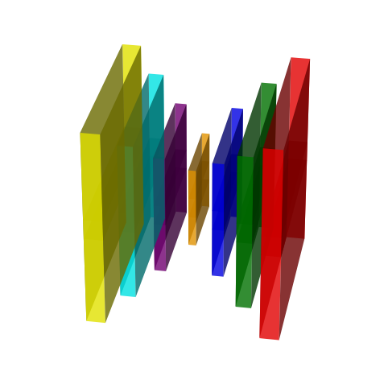
The idea of Encoder-Decoder Neural Networks
The encoder-decoder architecture can be used to compress an image into a smaller, more meaningful representation (like finding the important features) and to reconstruct it back into an image. This has two parts:
Encoder: This part compresses (encodes) the input (image) into a smaller, abstract representation.
Decoder: This part takes the compressed representation and reconstructs (decodes) it back into the original form (image).
The encoder takes in an image and processes it through several steps to shrink it down into a more compact form. It consists of:
Input Image: A 2D image, typically represented as a matrix of pixel values (e.g., 28x28 pixels for grayscale images or 64x64 for color images).
Convolutional Layers: These layers apply filters that scan over the image and extract important features, like edges, textures, or patterns. Each filter creates a "feature map" that represents the important features detected in the image.
Pooling Layers: These layers downsample the feature maps, reducing the image's size while keeping important information. Think of it as shrinking the image while retaining the key patterns.
Bottleneck: After several convolution and pooling steps, you reach the bottleneck layer (in orange), which is the smallest and most compressed version of the image, also called the latent space or feature representation. This captures the most essential information about the input image.

Slide 19
The idea of Encoder-Decoder Neural Networks
Why Use Encoder-Decoders?
Compression: The encoder compresses the input image into a much smaller representation, which is useful for things like removing noise or finding only the essential information in an image.
Reconstruction: The decoder allows you to reconstruct the image from the compressed version. This is useful for tasks like denoising, super-resolution (making low-res images clearer), or image segmentation (breaking down an image into different regions).
The decoder reverses the process. It takes the compressed representation (the bottleneck) and reconstructs the original image. It consists of:
Upsampling Layers: These layers gradually increase the size of the compressed representation, typically by reversing the downsampling process used by the encoder (like using ConvTranspose2d layers in PyTorch).
Deconvolutional Layers (Transposed Convolutions): These layers work similarly to convolutional layers but in reverse. Instead of reducing the size, they expand the smaller feature maps back to the original image size.
Output Image: The final layer reconstructs the image, trying to match the original input as closely as possible.

Slide 20
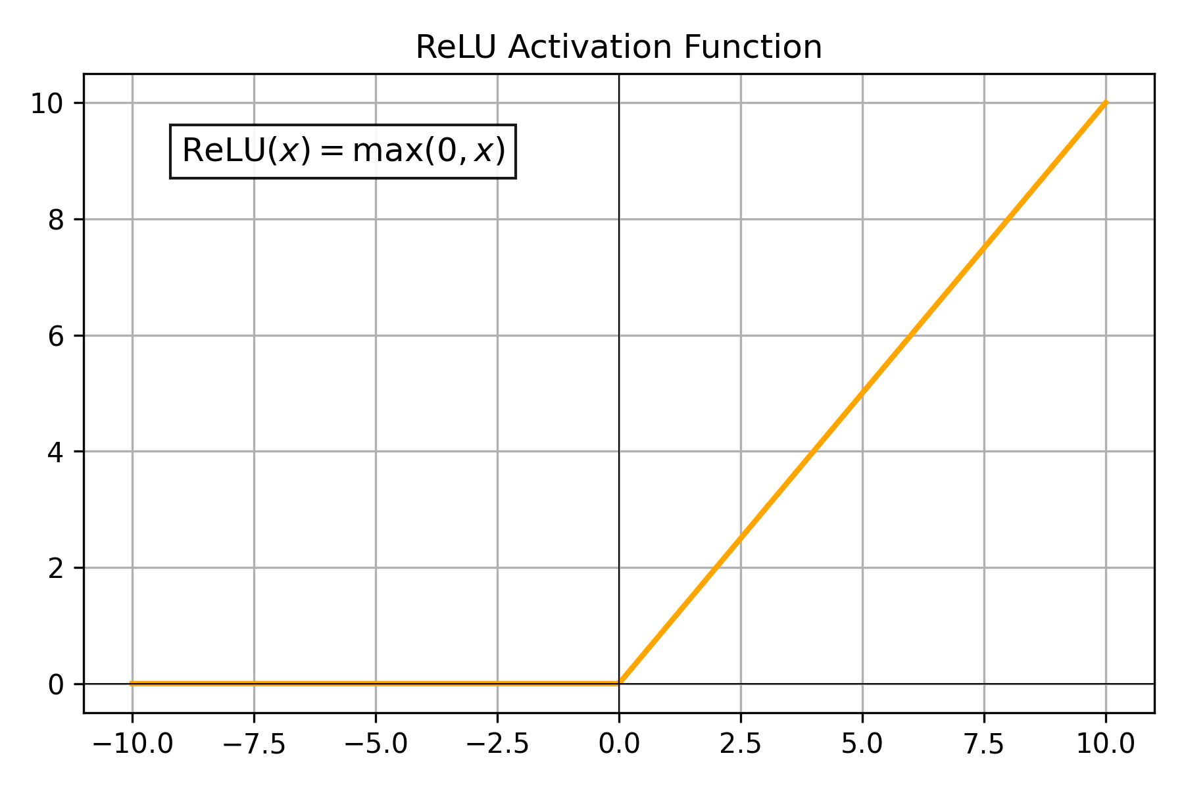
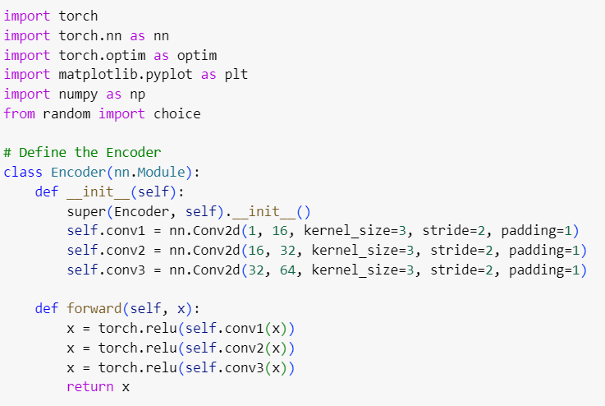
Define the Encoder
Convolutional Layers:
nn.Conv2d(in_channels, out_channels, kernel_size, stride, padding):
in_channels: The number of channels in the input image. For example, 1 for grayscale images and 3 for RGB images.
out_channels: The number of output channels (or feature maps). These represent the number of filters that are applied to the input image. In this case, the encoder will progressively learn more complex features with more filters.
kernel_size=3: The size of the filters used in the convolution. Here, the filter size is 3x3 pixels.
stride=2: The stride controls how much the filter moves over the input. A stride of 2 reduces the spatial dimensions of the output.
padding=1: Padding adds extra pixels around the input to maintain the spatial dimensions of the image. In this case, the padding is set to 1 to keep the size reduction controlled.

Slide 21
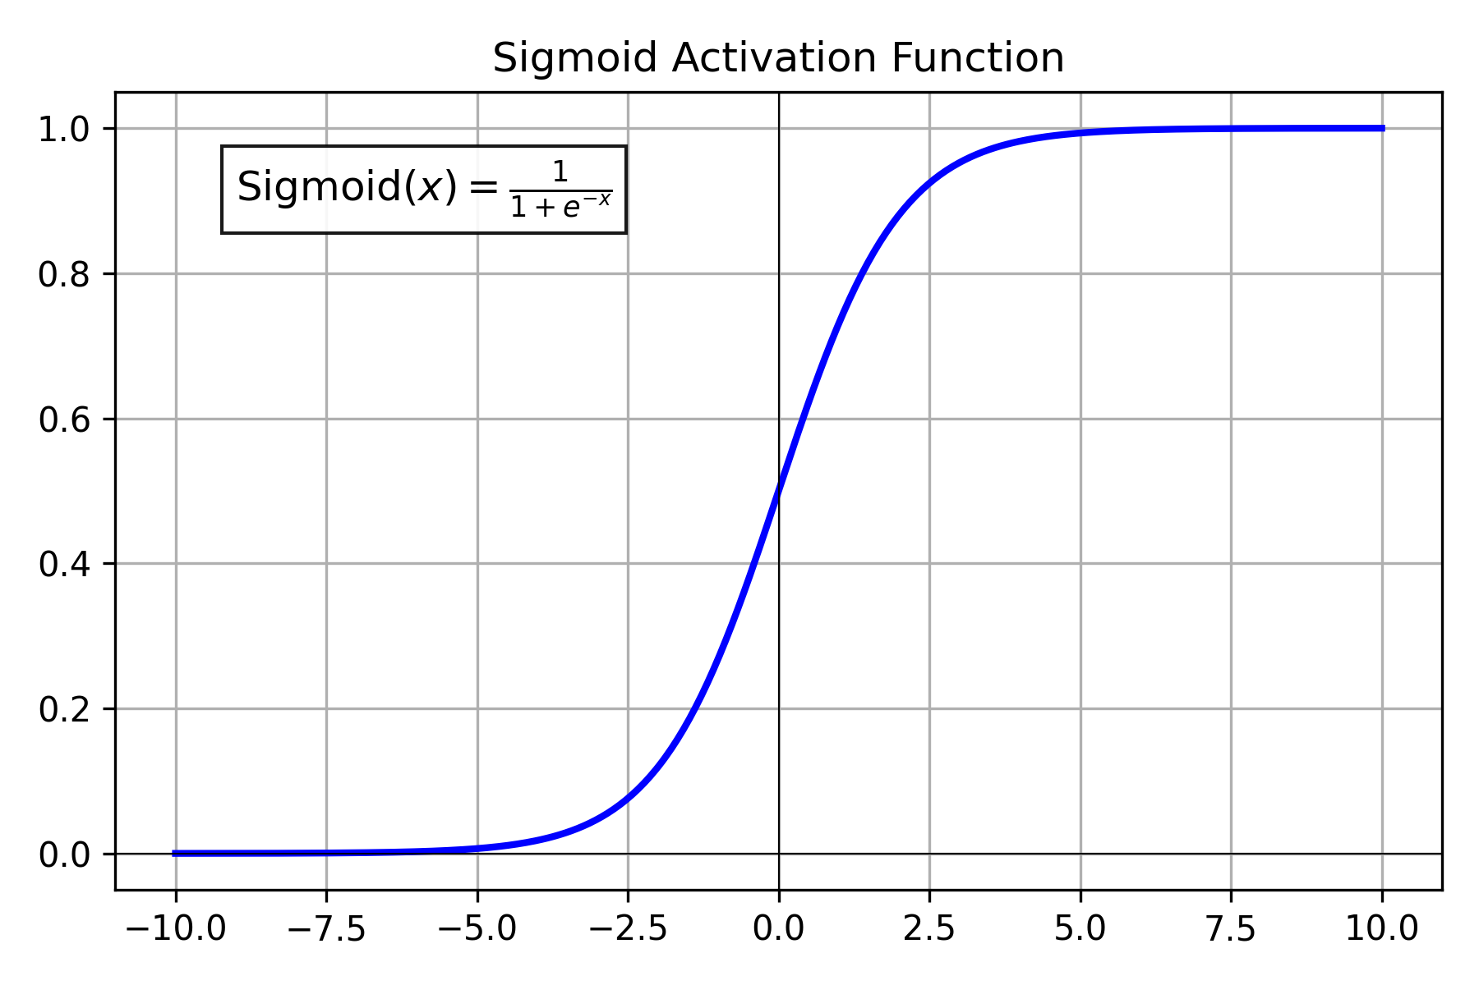
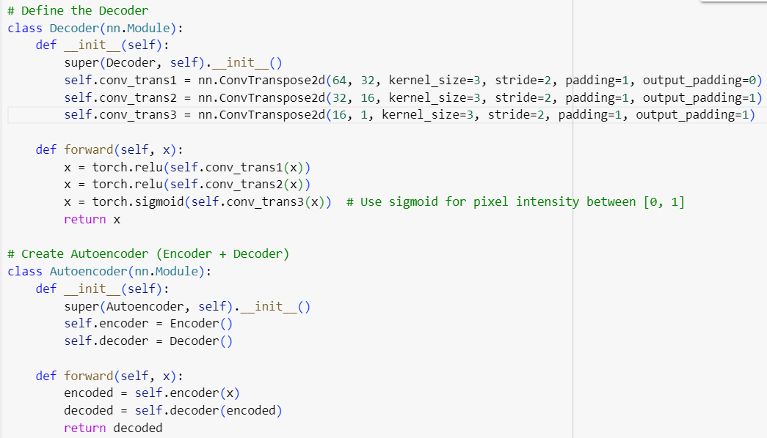
The Decoder and the Autoencoder
kernel_size=3: The size of the convolution filter (3x3 in this case), which affects how the up sampling is performed.
An autoencoder is a type of neural network used to learn efficient, compressed representations of data, often for dimensionality reduction or denoising. It consists of two main parts: an
encoder that compresses the input into a lower-dimensional form and
a decoder that reconstructs the original data from the compressed representation.

Slide 22
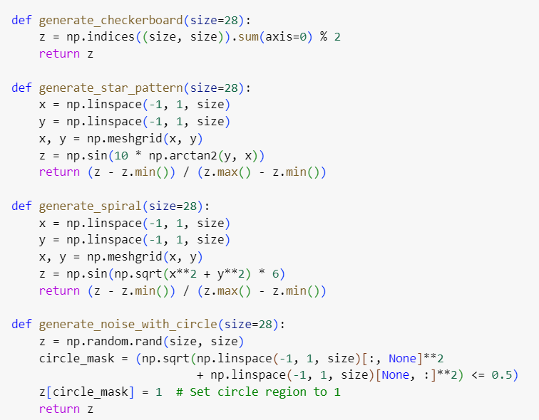
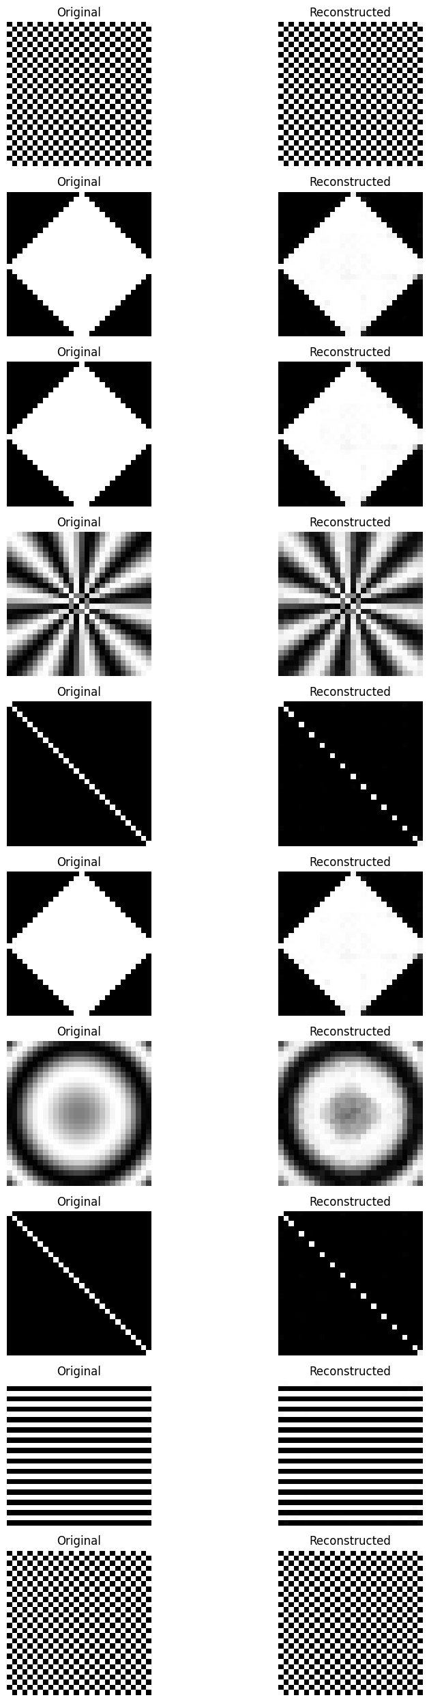
Generate Examples
We construct some patterns to work on it with our encoder decoder architecture.

Slide 23
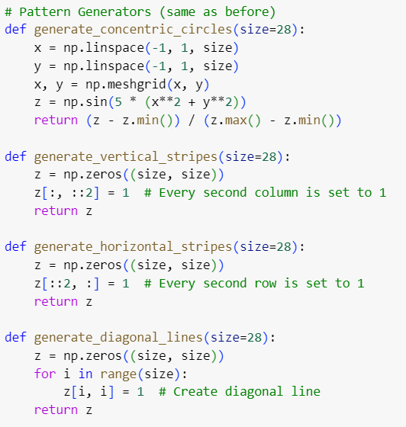
Construct Examples

Slide 24
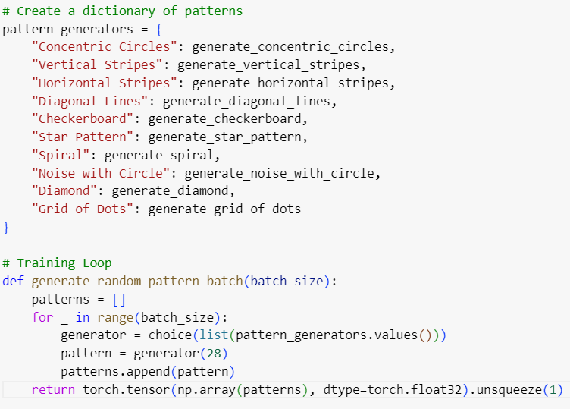
Generate a random pattern
We define a list of all our patterns to generate.
Then, for training we write a function which chooses from the list and generates a pattern.
It appends the pattern to the patterns list.

Slide 25
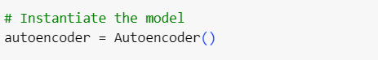
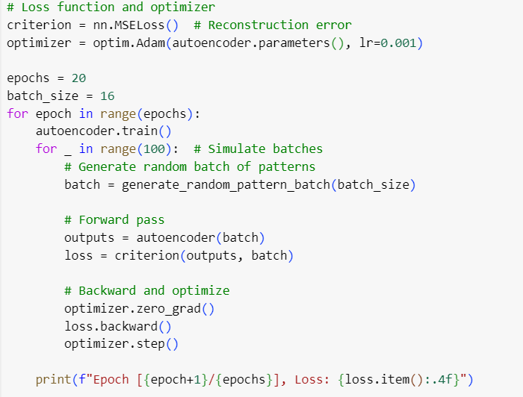
Training Loop
We now do the training based on standard PyTorch syntax
For all epochs
Run 100 steps with batches of size 16, i.e. processing a list of 16 images
Calculate loss and
update coefficients

Slide 26
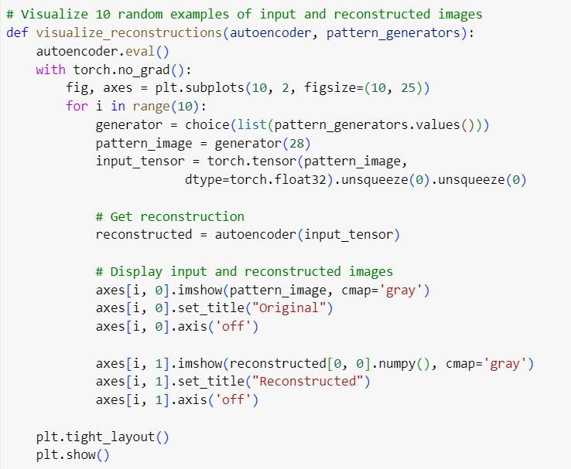
Visualization of Results
We define a visualization routine
Generating random input images
Then applying the autoencoder step
Showing input image and output image

Slide 27
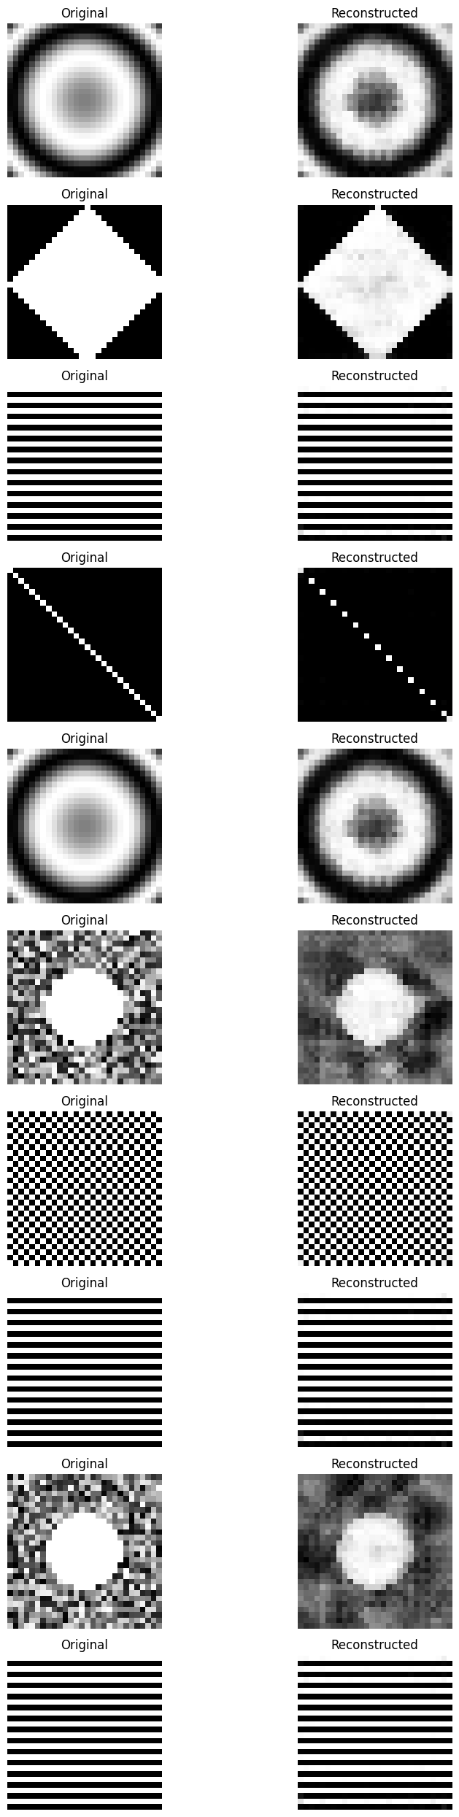
Original and Autoencoder Reconstruction
The Autoencoder applied to the original image should reconstruct the original image.
But we now have a tool where we can modify the imput, and then see if it can reconstruct the original input.

Slide 28
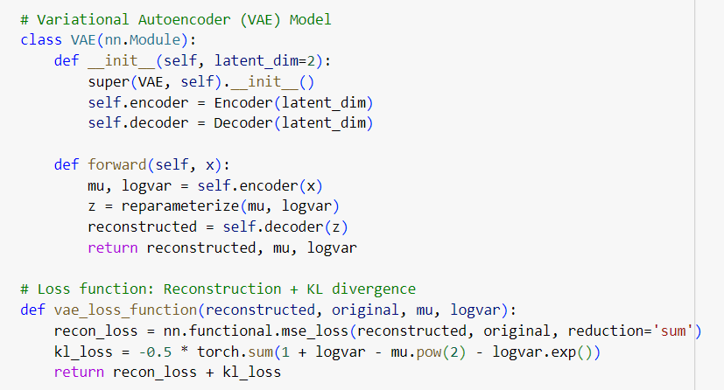
Define specific Loss Functions (e.g. Kullback-Leibler)
The KL (Kullback-Leibler) divergence is a measure of how one probability distribution differs from a second, reference probability distribution. It’s commonly used in various machine learning applications, especially in the context of probabilistic models.

Slide 29
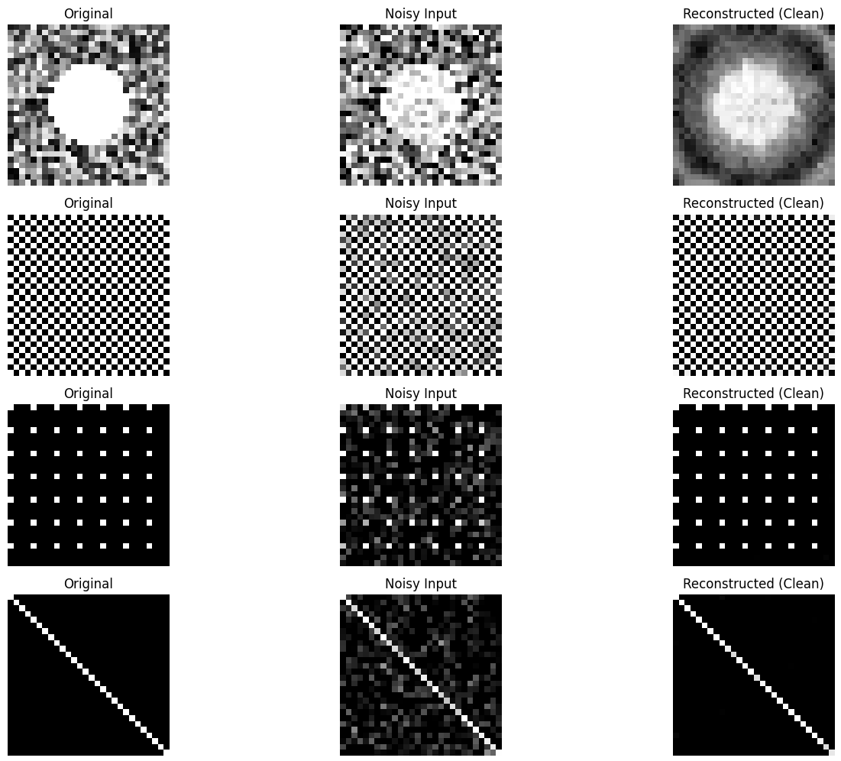
Reconstruct Noisy Images
We can add noise to the image before reconstruction.
This can also be taken into account during training.
The reconstructed image can remove the noise.

Slide 30
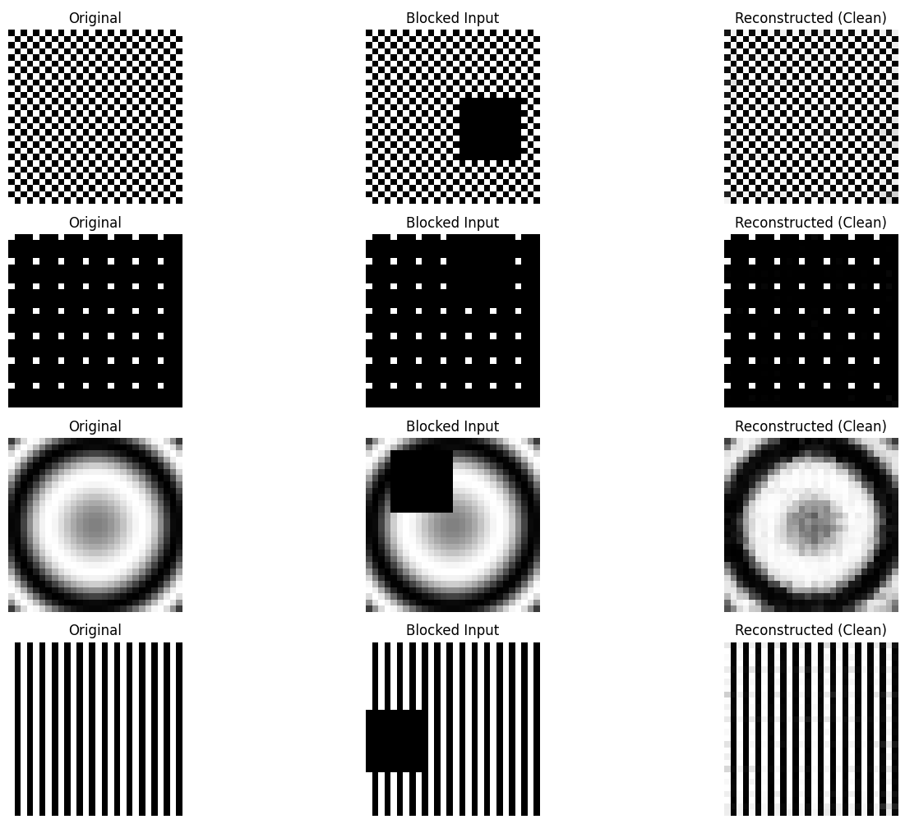
Reconstruct Missing Data
We can remove some parts of the patterns
Let the autoencoder reconstruct the missing parts.
This can also be added to the training loop to prepare the system.

Slide 31
E-AI Basic Tutorials
Tutorial E-AI Basics 1: September 16, 2024, 11-12 CEST
Intro, Environment, First Example
1.1 Basic Ideas of AI Techniques (20') [SH]
1.2 Work Environment (20') [RP]
1.3 First Example for AI - hands-on (20') [JK]
Tutorial E-AI Basics 2: September 18, 2024, 13-14 CEST
Dynamics, Downscaling, Data Assimilation Examples
2.1 Dynamic Prediction by a Graph NN (20') [RP]
2.2 Data Recovery/Denoising via Encoder-Decoder (20') [SH]
2.3 AI for Data Assimilation (20') [JK]
Tutorial E-AI Basics 3: September 23, 2024, 11-12 CEST
LLM Use, Transformer Example, RAG
3.1 Intro to LLM Use and APIs (20') [RP]
3.2 Transformer for Language and Images (20') [JK]
3.3 LLM Retrieval Augmented Generation (RAG) (20') [SH]
2.3
AI generated Images, © Roland Potthast 2024

Slide 32



Data assimilation example
Example with custom loss function
Normally, NNs are trained like this:
is known, i.e., the training data is sampled from
We take a different approach as data assimilation is also an optimization problem
→ We use the data assimilation cost function as loss function

Slide 33

Defining the loss function
The data assimilation cost function
The neural network is trained like this:
background
observations

Slide 34




Loading packages and preparing the data

Slide 35



Preparing the data (cont’d)

Slide 36




Preparing the data (cont’d)

Slide 37

Preparing the data (cont’d)

Slide 38

Network and Loss function

Slide 39


Network and Loss function

Slide 40


Training loop

Slide 41


Training loop

Slide 42


Results

Slide 43
E-AI Basic Tutorials
Tutorial E-AI Basics 1: September 16, 2024, 11-12 CEST
Intro, Environment, First Example
1.1 Basic Ideas of AI Techniques (20') [SH]
1.2 Work Environment (20') [RP]
1.3 First Example for AI - hands-on (20') [JK]
Tutorial E-AI Basics 2: September 18, 2024, 13-14 CEST
Dynamics, Downscaling, Data Assimilation Examples
2.1 Dynamic Prediction by a Graph NN (20') [RP]
2.2 Data Recovery/Denoising via Encoder-Decoder (20') [SH]
2.3 AI for Data Assimilation (20') [JK]
Tutorial E-AI Basics 3: September 23, 2024, 11-12 CEST
LLM Use, Transformer Example, RAG
3.1 Intro to LLM Use and APIs (20') [RP]
3.2 Transformer for Language and Images (20') [JK]
3.3 LLM Retrieval Augmented Generation (RAG) (20') [SH]
AI generated Images, © Roland Potthast 2024

